Slide 1
December 4, 2020
Coronavirus Impacts
and Implications
for US Construction
Ken Simonson
Chief Economist, AGC of America
ken.simonson@agc.org

Slide 2
AGC Survey Highlights
Coronavirus surveys conducted Oct. 7-19 (1,077 responses) & June 9-17 (635)
Workforce survey conducted Aug. 4-26; 2,005 responses
(Note: All percentages are % of respondents, not % of projects, dollars, etc.)
Scheduled project was canceled: 75% of respondents in Oct. survey, vs. 60% in Aug., 32% in June
Won additional project or add-on to project: 23%, similar to 21% in June
Currently experiencing any project delays/disruptions: 78%, vs. 57% in June
due to shortage of construction materials, equipment, or parts: 42%, vs. 25% in June
due to shortage of craftworkers or subcontractors: 35%, unchanged from June
Return to normal volume of business: already there 35%; will take more than 6 months 34%
Workforce survey:
Having hard time filling: craft positions 52% (80% in 2019 survey); salaried 28% (57% in 2019)
Source: Author

Slide 3
Total Nonfarm & Construction Employment, Feb.-Nov. 2020
cumulative change (seasonally adjusted)
Change to 11/20 from:
2/20
4/20
Residential Construction
-0.6%
17.5%
Nonresidential Construction
-5.6%
9.0%
Total Nonfarm
-6.5%
9.5%
2/20
3/20
4/20
5/20
6/20
7/20
8/20
9/20
10/20
11/20

Slide 4
Construction spending impacts: October vs. February
seasonally adjusted at annual rate
Total -0.2%; private residential 7% (single-family 4%; multi 11%); private nonres -6%; public -2%
Largest segments (in descending order of October 2020 spending)
Power -11% (electric -13%; oil/gas fields & pipelines -5%)
Education -4% (primary/secondary 3%; higher ed -14%)
Highway and street -11%
Commercial -3% (warehouse 5%; retail -12%)
Office -4%
Mfg. -9% (chemical -2%; electronic -16%; transp. equip. -20%; food/beverage -10%)
Transportation -1% (air -3%; freight rail/trucking -2%; mass transit 18%)
Health care -0.4% (hospital -2%; medical building -2%; special care 3%)
Lodging -17%
Source: Author

Slide 5
Construction input and ‘bid price’ producer price indexes
cumulative change in PPIs, Apr-Oct 2020 (not seasonally adjusted)
Inputs to new res construction Apr-Oct: 10.4%
Inputs to new nonres construction Apr-Oct: 6.3%
‘Bid price’ (new nonres building construction) Apr-Oct: -0.1%
4/20
5/20
6/20
7/20
8/20
9/20
10/20

Slide 6
Construction impacts to date
Steep job loss, Feb.-April: -1.1 million (14% of Feb. total)
Rebound, April-November: 804,000 (74% of Feb.-April loss)
Diverging job gains as % of loss: residential, 96%; nonresidential, 58%
PPP loans helped firms (re)hire workers but funds are running out
Few new project announcements; cancellations are growing
Home building, additions and renovations are very strong; mixed multifamily
Increasing weakness among private nonres, state & local segments
Source: Author

Slide 7
Medium-term impacts as recovery begins
Sustained economic recovery depends on safe, effective vaccine that enough of the public actually takes
Slower rebound than for other sectors as owners, investors/lenders, institutions and public agencies have lost revenue and face uncertainty about future demand
Best private prospects: remodeling, local distribution centers, data centers
Less demand than pre-crisis for retail, offices, higher ed, cultural facilities
Probably less demand for sports, entertainment, lodging & travel-related
Best public prospects: depends on federal funding & election outcome
Additional highway funding likely; other infrastructure remains uncertain
Less state & local building construction, especially higher ed
Source: Author

Slide 8
Long-run construction outlook (post-pandemic)
Slower population growth means slower demand growth for most construction
Permanent shift from retail to e-commerce/distribution structures
More specialized and online healthcare facilities; fewer hospitals, nursing homes
Continuing demand for K-12 but much less for higher ed construction
Demand for restaurants should revive sooner than hotels, travel-related construction
Not clear if offices will decentralize or remain in less demand
No sign of change yet in urban/rural or state-to-state trends
Source: Author

Slide 9
Population change by state, July 2018–July 2019 (U.S.: 0.48%)
Decrease
0-0.49%
0.5-0.99%
1.0-1.49%
1.5%+
1.2%
2.1%
Top 5
ID | 2.1%
NV | 1.7%
AZ | 1.7%
UT | 1.7%
TX | 1.3%
0.8%
0.4%
0.9%
0.5%
0.6%
NH 0.5%
0.3%
-0.4%
VT
-0.1%
0.2%
0.7%
0.03%
0.1%
1.7%
0.2%
0.01%
MA 0.1%
1.7%
0.5%
-0.4%
0.1%
1.2%
0.5%
-0.7%
0.1%
0.3%
0.4%
CT -0.2%
RI 0.1%
0.1%
Bottom 5
WV | -0.7%
AK | -0.5%
IL | -0.4%
NY | -0.4%
HI | -0.3%
1.7%
1.0%
DE 0.9%
NJ -0.04%
0.2%
0.4%
0.8%
1.3%
0.3%
1.3%
-0.2%
0.3%
1.0%
MD
0.2%
DC
0.6%
AK
-0.5%
-0.2%
1.1%
HI -0.3%
Source: U.S. Census Bureau

Slide 10
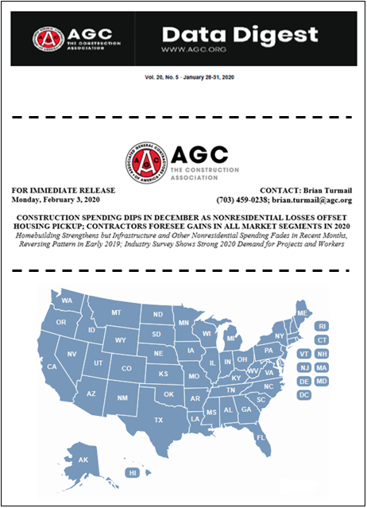
AGC economic resources
(email ken.simonson@agc.org)
The Data DIGest: weekly 1-page email (subscribe at http://store.agc.org)
Surveys, state and metro data, fact sheets: www.agc.org/learn/construction-data
Monthly press releases: construction spending; national, state, metro employment with rankings
Coronavirus resources: www.agc.org/coronavirus
Source: Author

